Slide 1
Lecture – 1 Introduction to Computer Programming

Slide 2
Basic Component of a c program
A C program basically has the following component:
Preprocessor Commands
Functions
Variables
Statements & Expressions
Comments

Slide 3
C Basic Program and Explanation
S. no | Code | Explanation
1. | #include <stdio.h> | This is a preprocessor command that includes standard input output header file(stdio.h) from the C library before compiling a C program
2. | int main() | This is the main function from where execution of any C program begins
3. | { | This indicates the beginning of the main function.
4. | /*_some_comments_*/ | whatever is given inside the command “/* */” in any C program, won’t be considered for compilation and execution
5. | printf(“Hello_World! “); | printf command prints the output onto the screen.
6. | return 0; | This command terminates C program (main function) and returns 0.
7. | } | This indicates the end of the main function.

Slide 4
Comments in C
A comment is a note to yourself or others that you put in your source code.
All comments are ignored by compiler.
Comments are used primarily to document the meaning and purpose of your source code , so that you can remember later how it functions and how to use it.
Comments are mainly two types :
Single line Comment
Multi line Comment

Slide 5
Single Line Comment
Single Line Comment is used to comment out just Single Line in the Code. It is used to provide One Liner Description of line.
Basic Characters of Single Line Comment:
Single Line Comment Can be Placed Anywhere except the middle of any c keyword, function name, or variable name.
Single Line Comment Starts with ‘//’
Any Symbols written after ‘//’ are ignored by Compiler
Comment cannot hide statements written before ‘//’ and On the Successive new line

Slide 6
Multi Line Comment
Multi line comments can extend over several line or may be confined within a line.
Basic Characters of Multi Line Comment:
Multi line comment can be placed anywhere except the middle of any c keyword, function name, or variable name.
Multi line comment starts with /*.
Multi line comment ends with */.
Any symbols written between '/*' and '*/' are ignored by Compiler.
It can be split over multiple lines

Slide 7
Let us consider another example:
#include <stdio.h> //This is needed to run printf() function.
int main()
{
printf("C Programming"); //displays the content inside quotation
return 0;
}
Output
C Programming

Slide 8
Explanation of How this program works
Every program starts from main() function.
printf() is a library function to display output which only works if #include<stdio.h>is included at the beginning.
Here, stdio.h is a header file (standard input output header file) and #include is command to paste the code from the header file when necessary. When compiler encounters printf() function and doesn't find stdio.h header file, compiler shows error.
Code return 0; indicates the end of program. You can ignore this statement but, it is good programming practice to use return 0;.

Slide 9
Escape Sequences
Escape Sequences | Character
\b | Backspace
\f | Form feed
\n | Newline
\r | Return
\t | Horizontal tab
\v | Vertical tab
\\ | Backslash
\' | Single quotation mark
\" | Double quotation mark
\? | Question mark
\0 | Null character

Slide 10
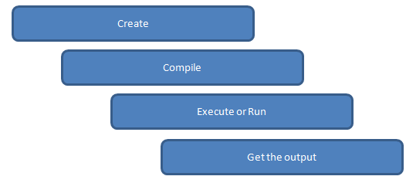
Steps to write C programs and get the output:
Below are the steps to be followed for any C program to create and get the output. This is common to all C program and there is no exception whether its a very small C program or very large C program.

